Slide 1
COVARIANCE
→Definition
→Formula
→Values
→Properties
→Change
→Examples
→Inference
Notes:
Different Definitions - Variation between variables, Movement of X wrt Y, relationship between X & Y, Extent of variation, degree of variation
Graphs (Normal & Higher Std Deviation)
Formula for Mean deviation, Variance, Standard Deviation
Units of Measurement (Covariance formula)

Slide 2
COVARIANCE DEFINITION
Directional relationship between two variables

Slide 3
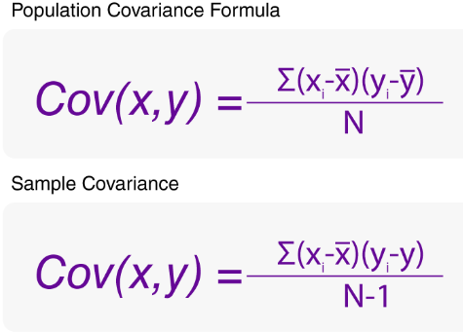
FORMULA

Slide 4
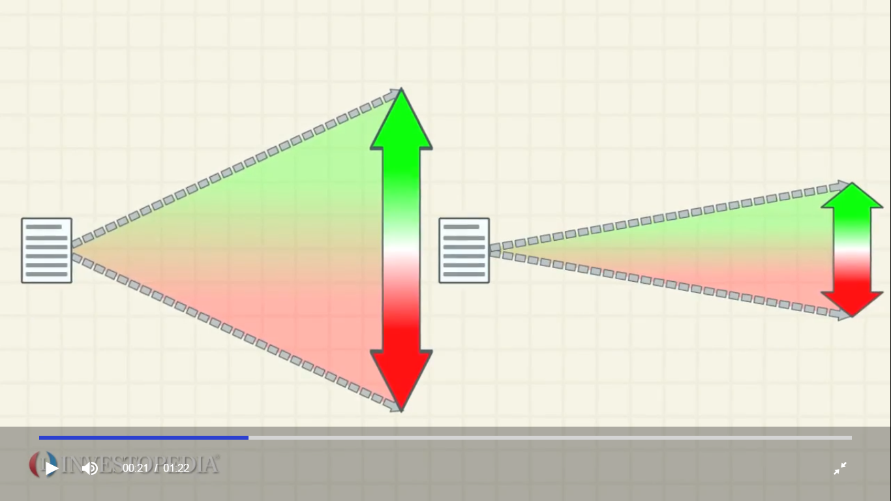

VARIANCE VS COVARIANCE
Single Variable Analysis
Consistent
Comparison
Bivariate Analysis
Relationship
Comparison

Slide 5
COVARIANCE CHARACTERISTICS
→Values +α to -α
→Properties Has Unit.
→Change Origin – No Effect
Scale – Affects

Slide 6
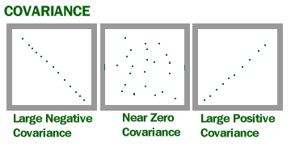
COVARIANCE VALUES

Slide 7
RELATIONSHIP CHARACTERISTICS
1)I have Variable 1, Variable 2 ,Variable 3 as data with me.
Are they related ? What will happen if Variable 1 increase ?
2)If Variable 1 increase what will happen to Variable 2 ?
3)What is the estimated value of Variable 1 if variable 2 is known
(Statistical approach to descriptive analysis of Data)
Covariance between X & Y
1)When X gets bigger, does Y get bigger, or smaller?
2)Does Y get a lot bigger/smaller, or just a little bit?
Direction & Strength of relationship plays an important role
Example
I am the owner of a textile showroom. I want to increase my profits.
I have the following data: number of customers who visited my shop everyday,
no of employees in shop, everyday Temperature, Free offer day details, New
arrival stock details, Price listing of all clothes etc

Slide 8
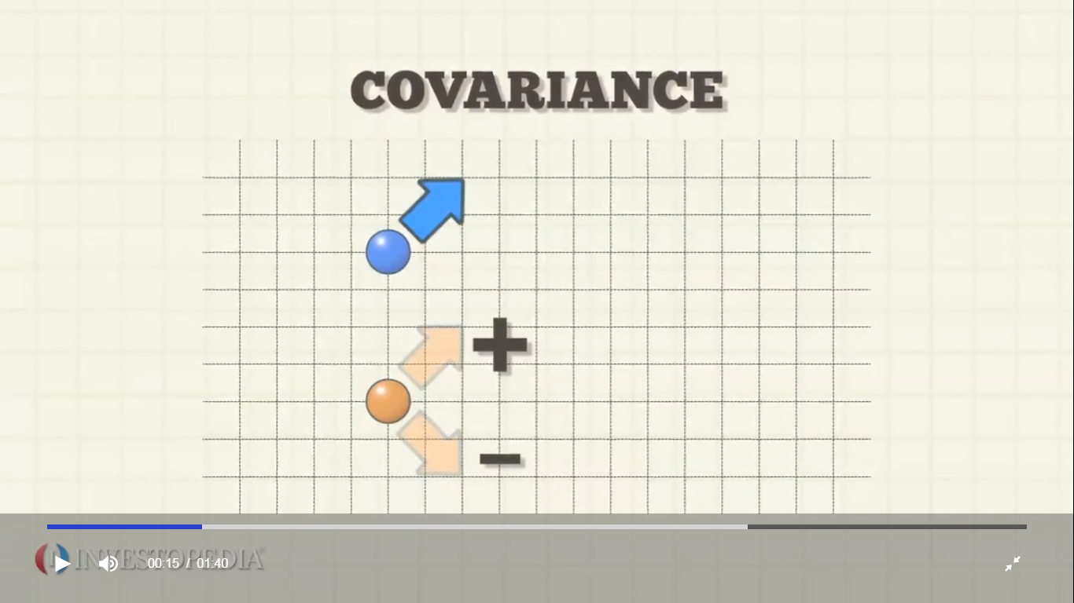
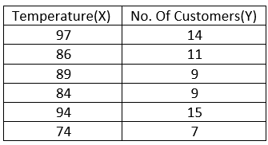
COVARIANCE EXAMPLE 1
COV(x, y) = 112.33/(6–1) = 112.33/5 = 22.46
The covariance between the temperature and customers is 22.46.

Slide 9
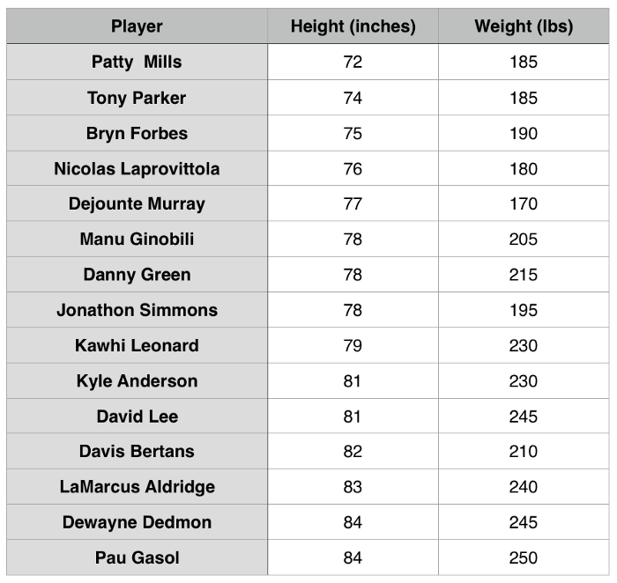
COVARIANCE EXAMPLE 2
The covariance is 78.3

Slide 10
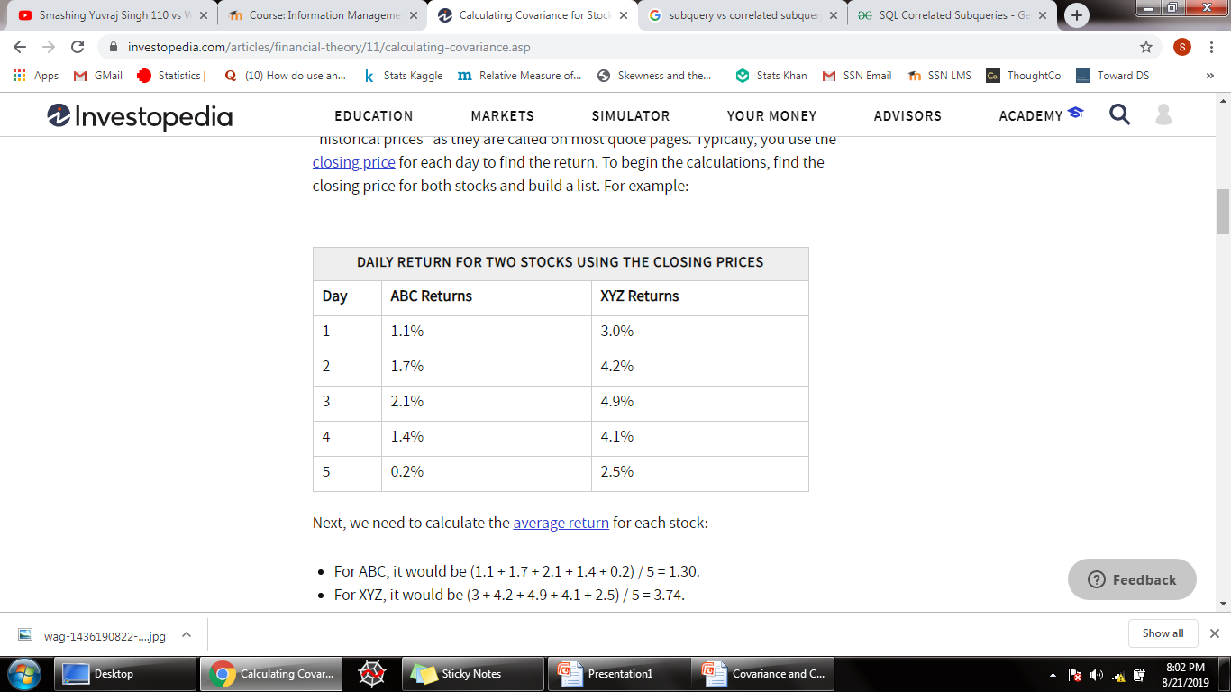
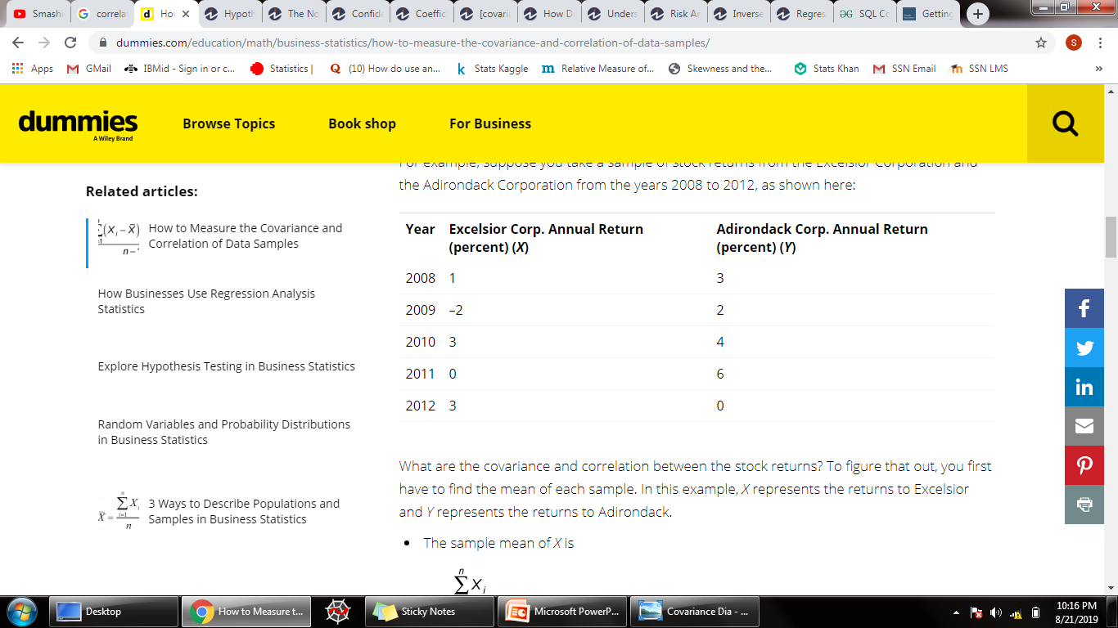
COVARIANCE EXAMPLE 3
The covariance is 0.665
The covariance is -1

Slide 11
COVARIANCE
EX1 - 22.46 (Temperature Vs Customers)
EX2 - 78.3 (Height Vs Weight)
EX3 - 0.665 (Annual Return of ABC & XYZ)
EX4 - -1 (Annual Return of Excelsior &
Adirondack)
Comment on relationship : Strength & Direction
Difference between Units of Measurement

Slide 12
Statistical Result
The covariance between the temperature and customers is 22.46.
Since the covariance is positive, temperature and number of customers have a positive relationship.
As temperature rises, so does the number of customers.
But here there is no information about how strong the relationship is, and that’s where correlation comes into the picture.
Statistical Inference
Actual Inference

Slide 13
COVARIANCE IN FINANCE DECISON
Covariance measures the directional relationship between two stock returns and can help in portfolio management
Positive Covariance & Negative covariance are used as a statistic tool by stock portfolio managers to decide the investment plans
Most investors select the stocks that move in opposite direction because the risk will be lower although they will provide the same amount of potential return

Slide 14
COVARIANCE EXAMPLE 3
The covariance is 0.665
The covariance is -1

Slide 15
COVARIANCE APPLICATION
COVARIANCE MATRIX
CORRELATION MATRIX
PCA (Principal Component Analysis & Dimensionality reduction)

Slide 16
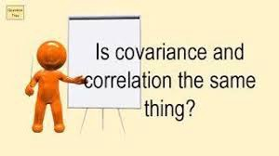
→Definition
→Formula
→Values +α to -α
→Properties Has Unit.
→Change Origin – No Effect; Scale – Affects
→Examples Single Variable Analysis Bivariate Analysis
Consistent Relationship
Comparison Comparison
Variance Covariance
Relationship
1)When X gets bigger, does Y get bigger, or smaller?
2)Does Y get a lot bigger/smaller, or just a little bit?
→Inference
→Relation
Directional relationship between 2 variables
Notes:
1)Direction
2)Strength

Slide 17
CORRELATION
→Definition
→Formula
→Values
→Properties
→Change
→Examples
→Inference
→Relation

Slide 18
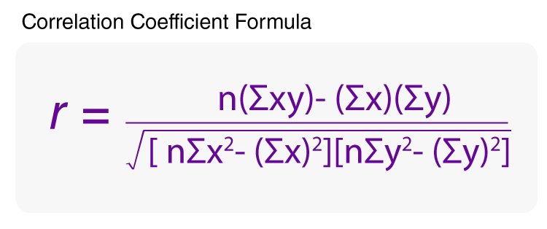
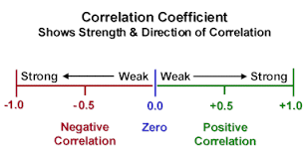
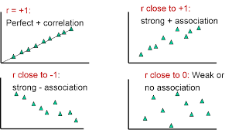
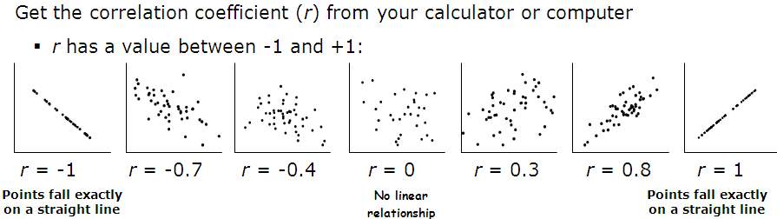
→Definition Linear Association between different variables
(Strength & Direction of relationship)
→Formula
→Values
→Properties No Unit
→Change Not Affected by Origin or scale
→Examples Banking & Commodity Prices
→Inference
→Relation

Slide 19
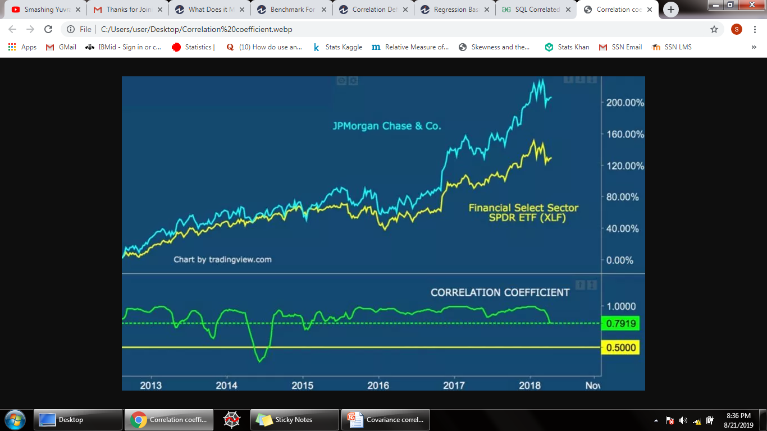
Notes:
Understanding the correlation between two stocks or a stock and its industry can help investors gauge how the stock is trading relative to its peers. All types of securities, including bonds, sectors and ETFs can be compared with the correlation coefficient.
a company's stock prices and other explanatory variables such as the daily change in trading volume and the daily change in market returns

Slide 20
EXAMPLE 1
In the chart below, we compare one of the largest U.S. banks JPMorgan Chase & Co. (JPM) with the Financial Select SPDR ETF (XLF). As you can imagine J.P. Morgan should have a positive correlation to the banking industry as a whole.
We can see the correlation coefficient (bottom of the chart) is currently at .7919, which is close to signaling a strong positive correlation. A reading above .50 typically signals a strong positive correlation.

Slide 21
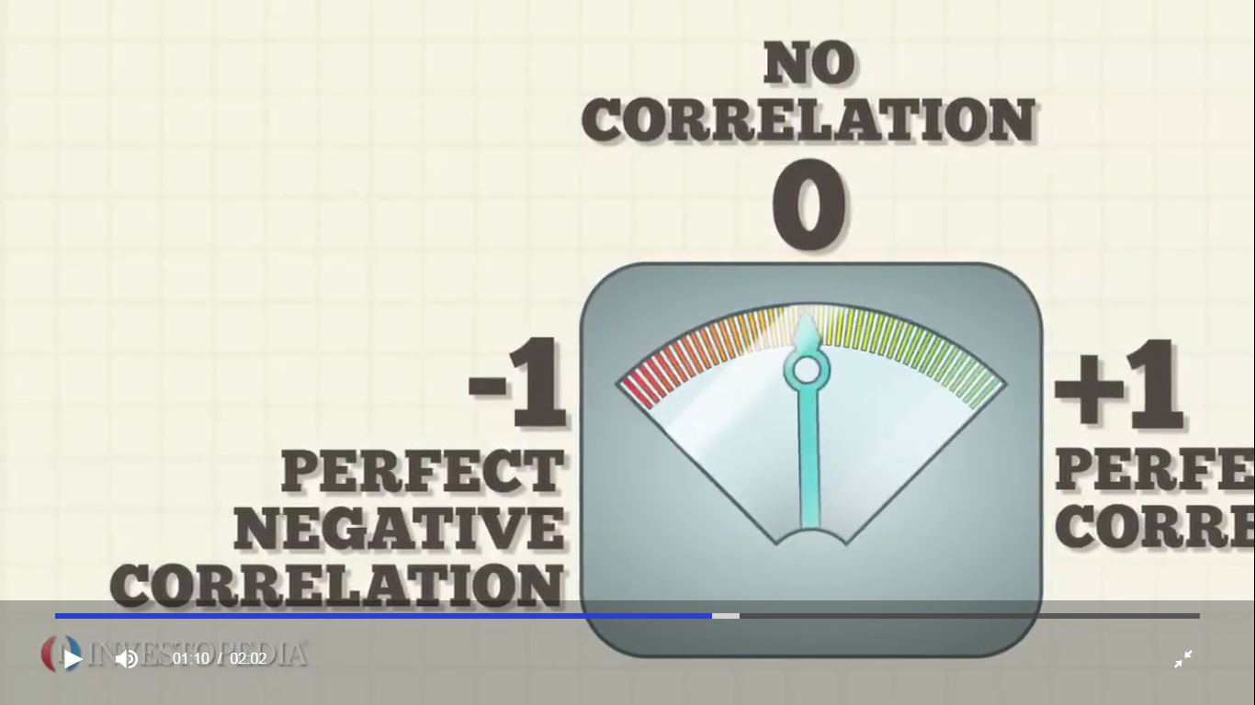
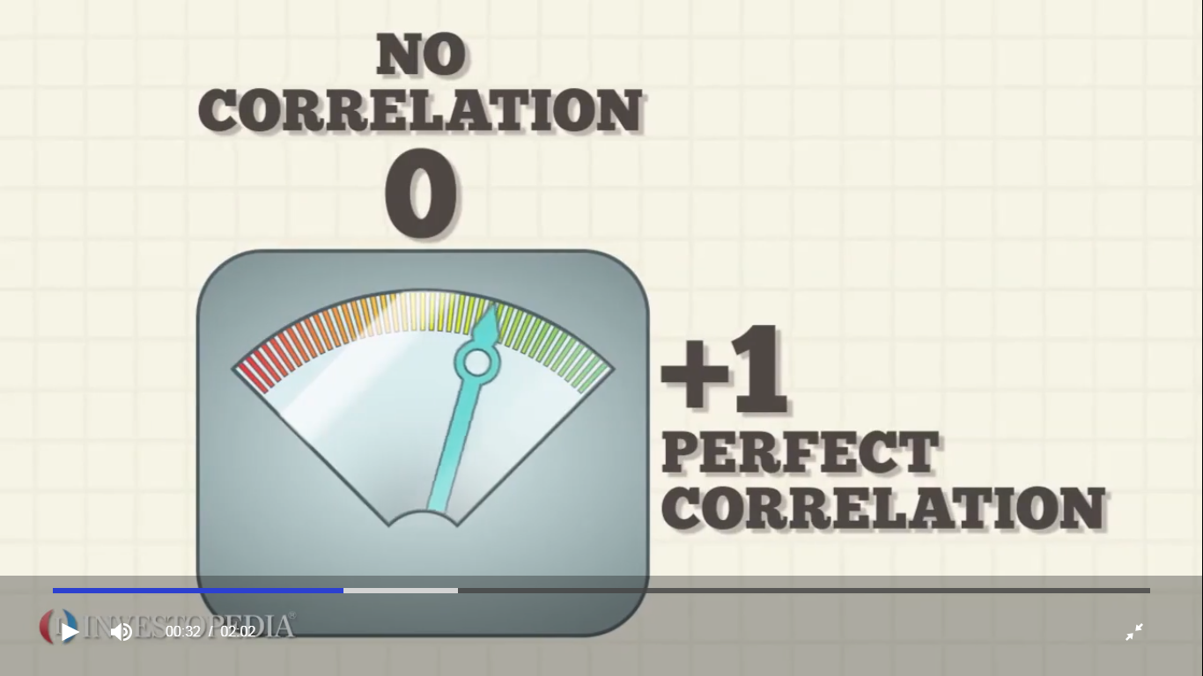
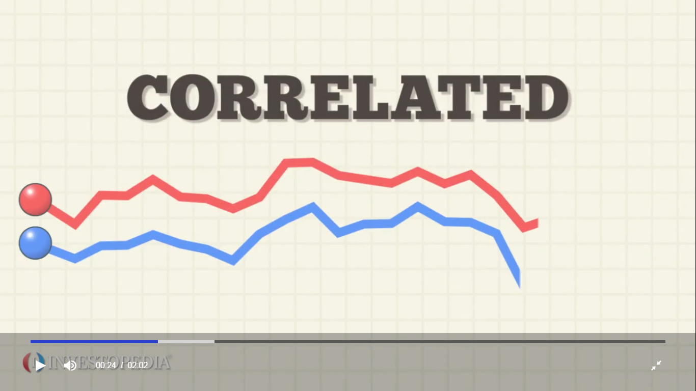
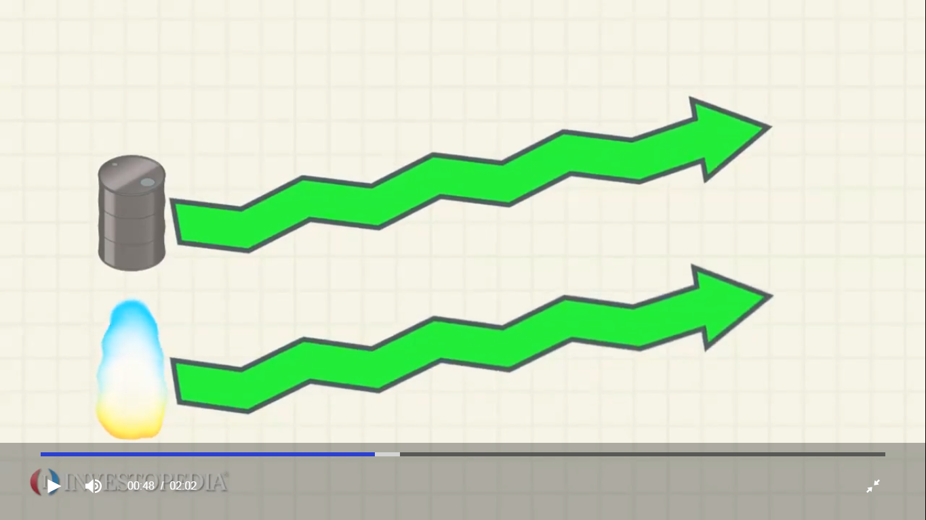
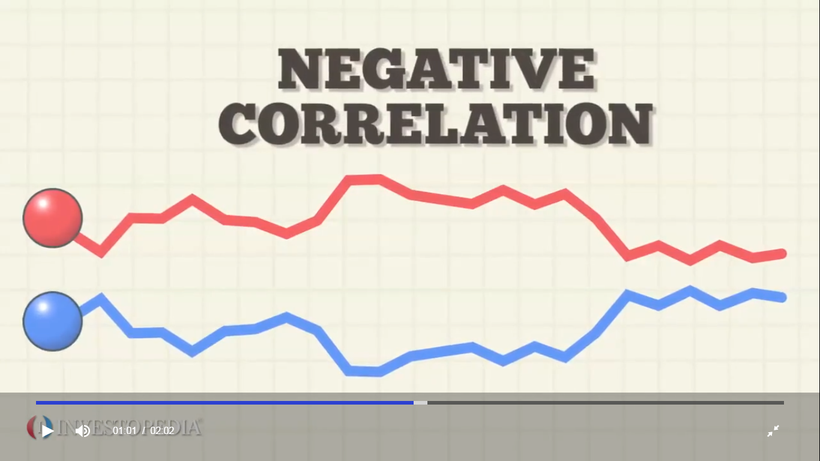
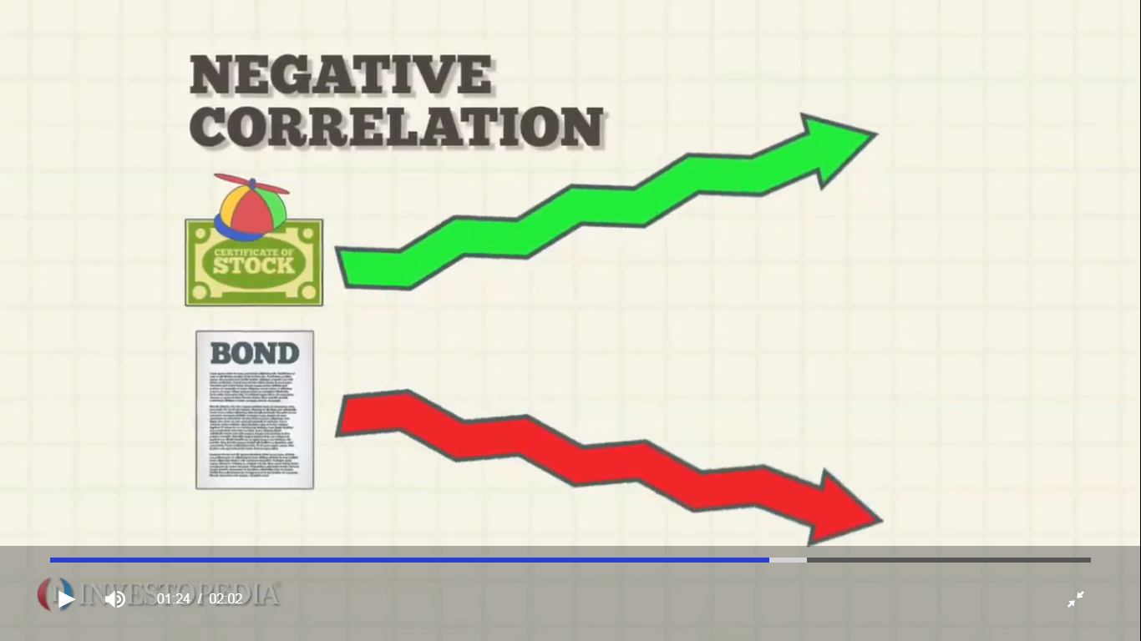
Based on the price patterns observed over the last decade, Crude Oil Prices & Gas based fuel prices are correlated. This seems to indicate a high level of dependency and similar price movement for the two commodities.
US DOLLAR PRICE & GOLD
As the US Dollar depreciates against major currencies, gold is generally perceived to rise and when US dollar appreciates gold declines in price

Slide 22
RELATIONSHIP INFERENCE
Comparison
r A = 0.4 & r B = 0.8
Can u say that correlation in B = twice as high as correlation in the first case ?
Functional relationship between variables or
extent of variation of X wrt Y or
Proportion of change in X wrt Y or
How much X changes wrt Y or
Mathematical relationship between X & Y
is not explained by correlation but by regression

Slide 23
REGRESSION
Functional relationship
between
different variables

Slide 24
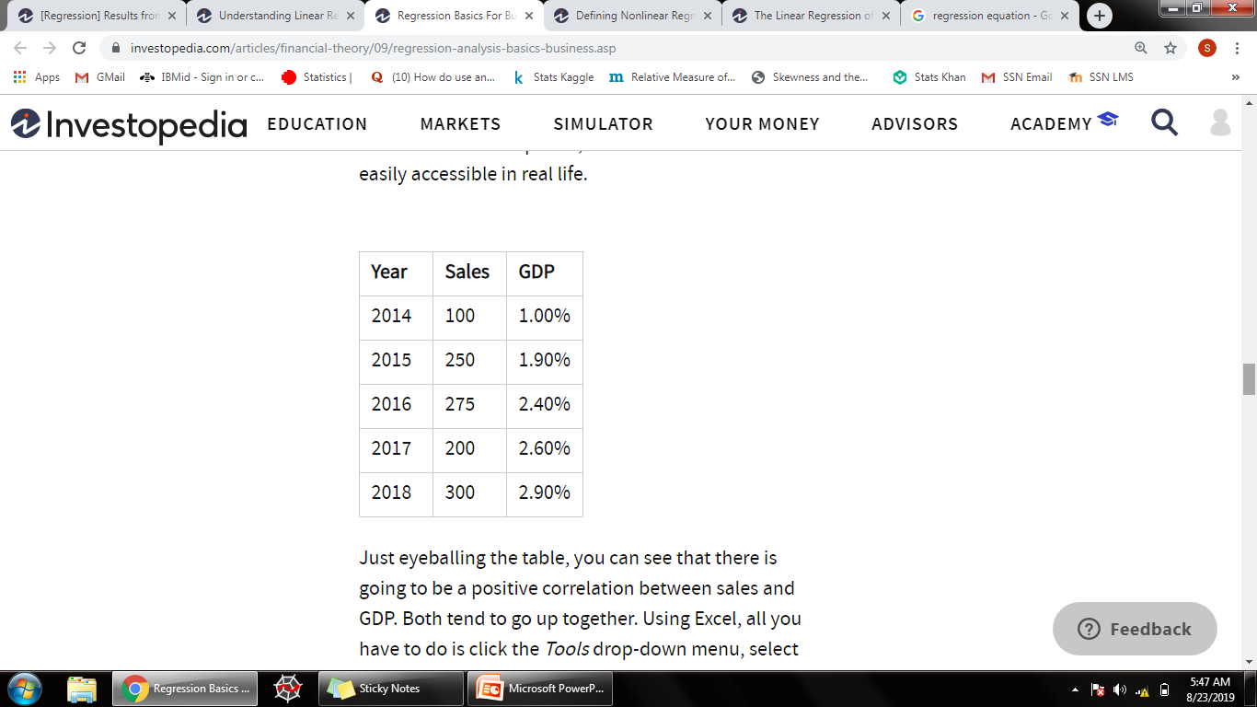
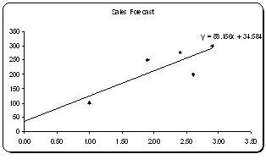
INFERENCE
suppose you want to forecast sales for your company and you've concluded that your company's sales go up and down depending on changes in GDP
if there was no change in GDP, your company would still make some sales - this value, when the change in GDP is zero, is the intercept.
we have an intercept of 34.58, which tells us that if the change in GDP was forecasted to be zero, our sales would be about 35 units. And finally, correlation coefficient of 88.15 tells us that if GDP increases by 1%, sales will likely go up by about 88 units.

Slide 25
APPLICATION : USE CASES
Regression helps investment and financial managers to value assets and understand the relationships between variables, such as commodity prices and the stocks of businesses dealing in those commodities.
Linear regression uses one independent variable to explain or predict the outcome of the dependent variable Y, while multiple regression uses two or more independent variables to predict the outcome.
Regression can help finance and investment professionals as well as professionals in other businesses. Regression can also help predict sales for a company based on weather, previous sales, GDP growth, or other types of conditions.

